Slide 1
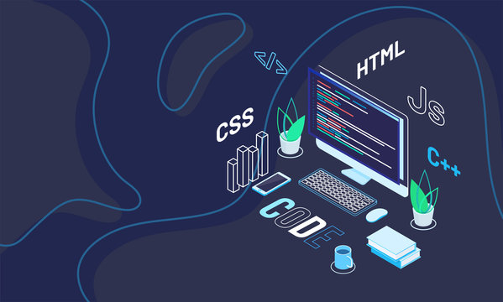






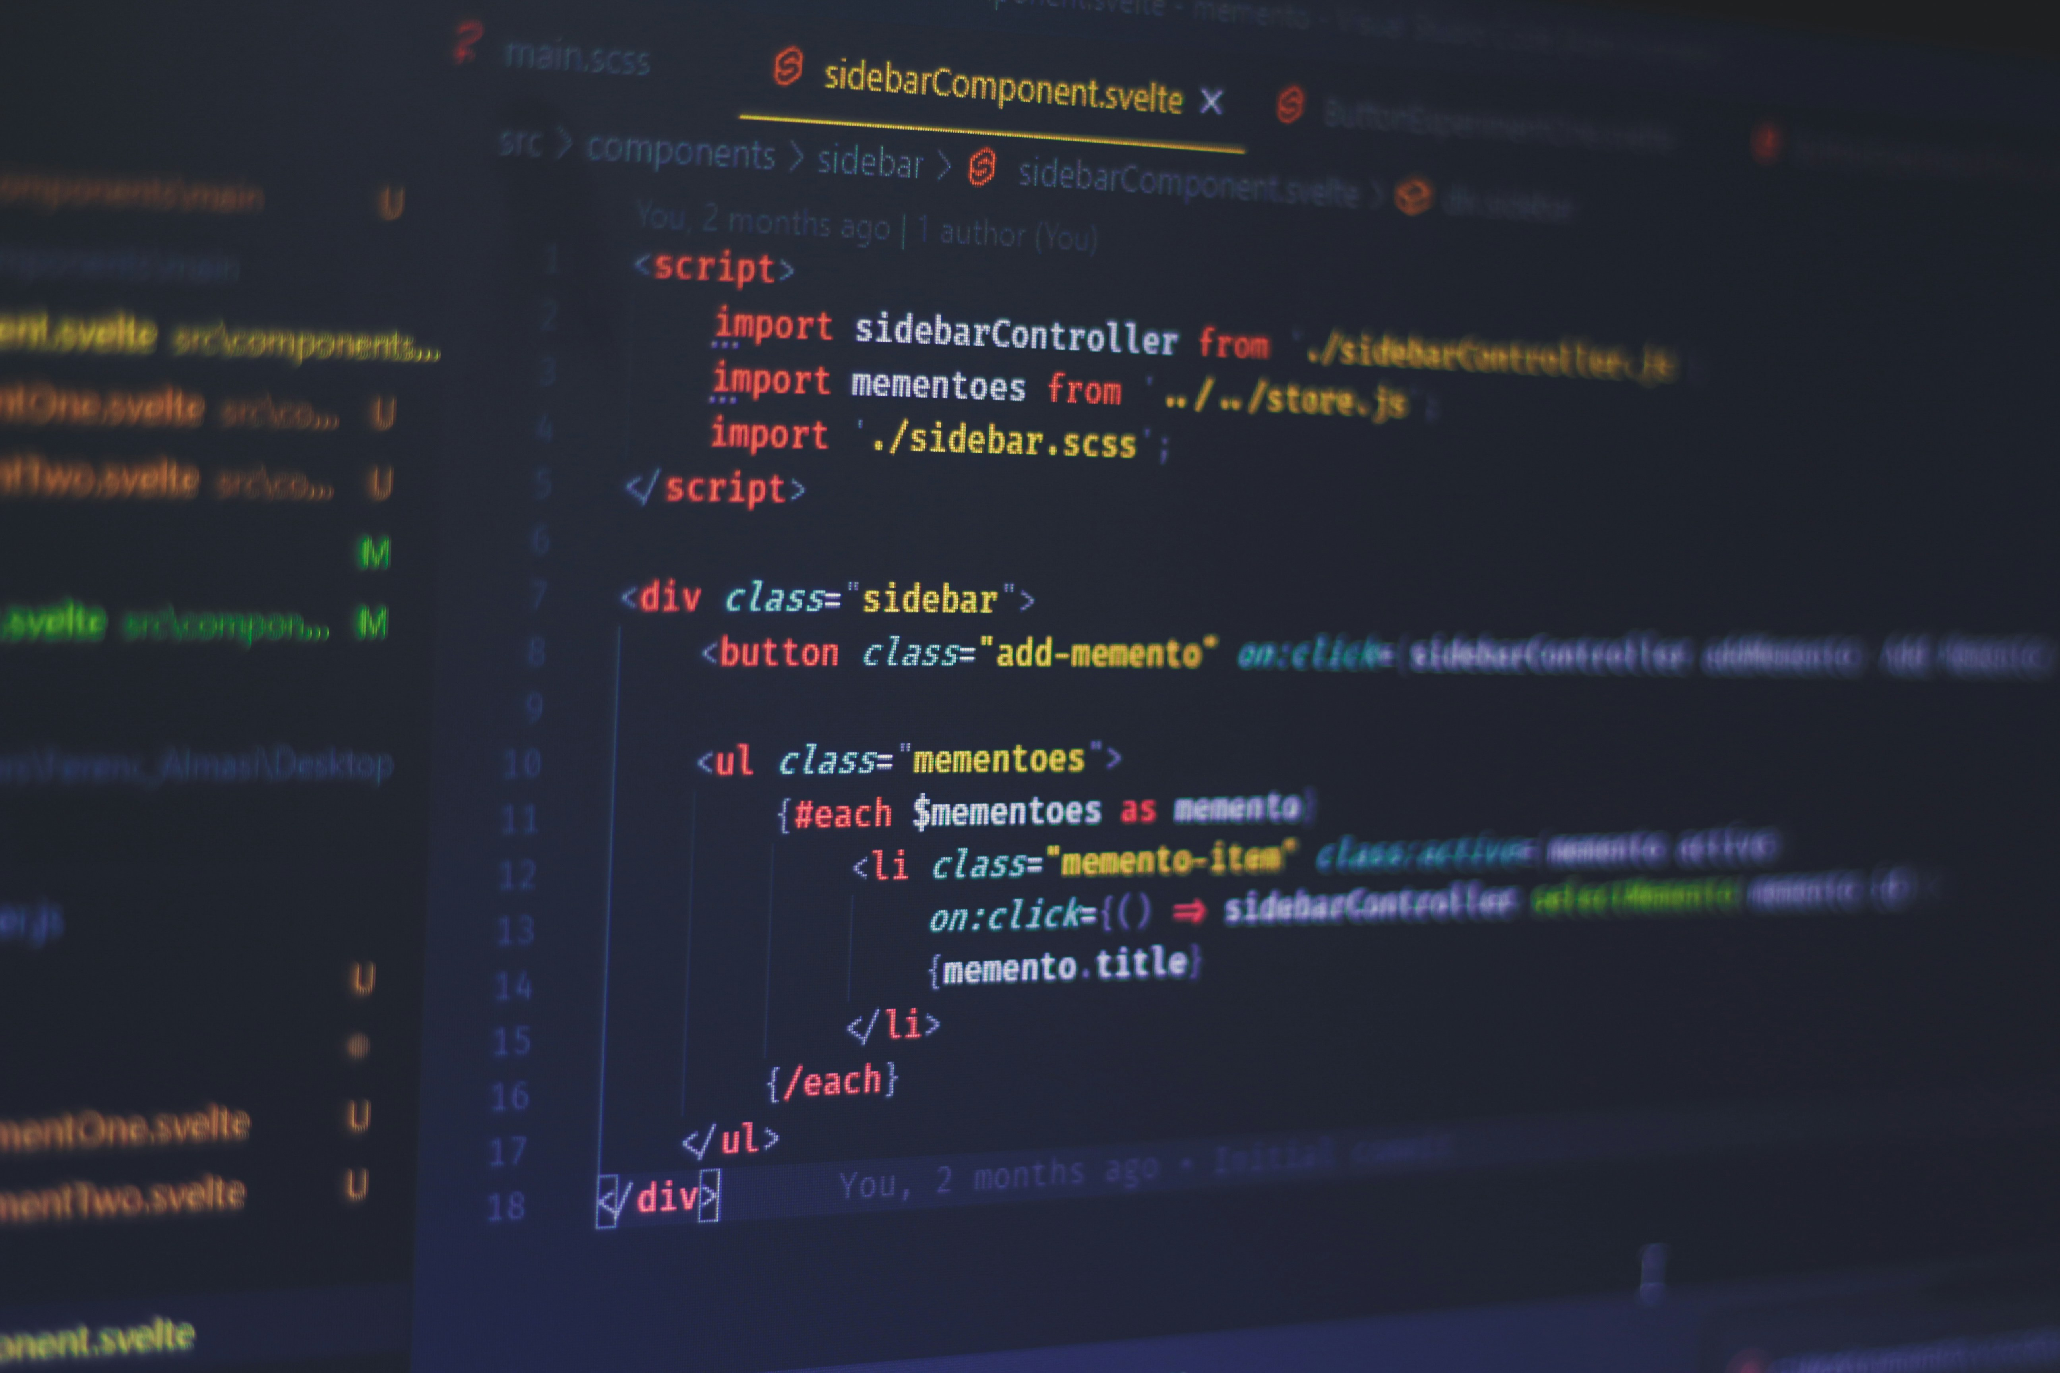

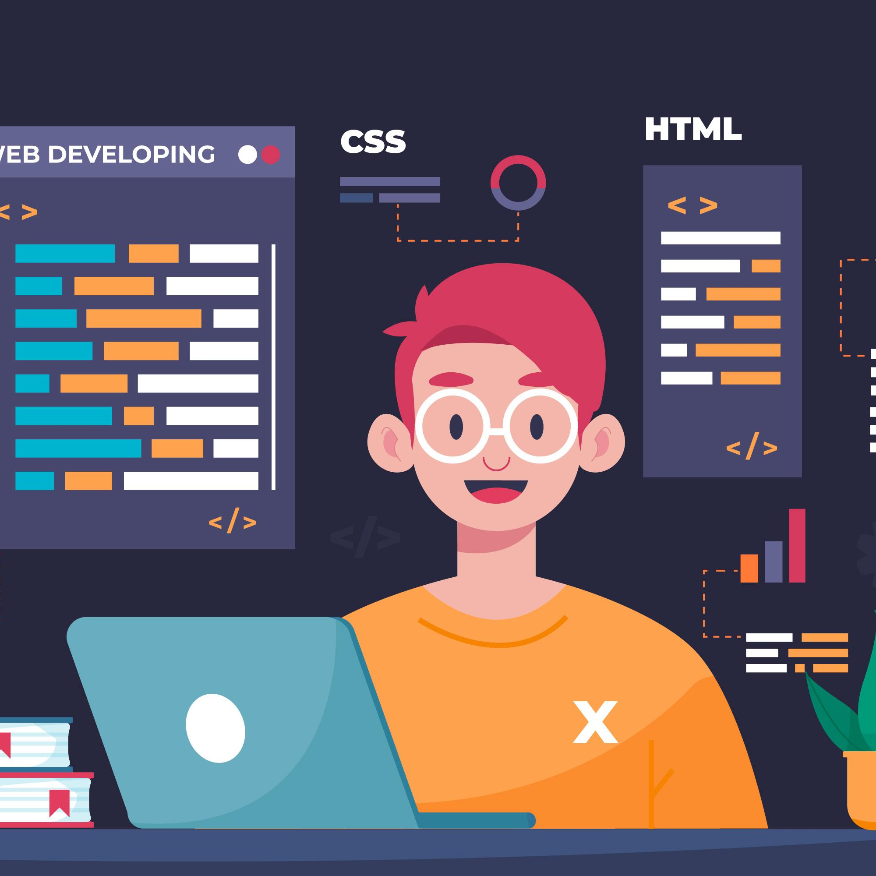


Introduction to
Web Development
What is web development?
Creating websites and web applications using code and design tools
Includes frontend (what users see) and backend (what happens behind the scenes)

Slide 2
Types of Web Development
Frontend: Layout, design, interactivity (HTML, CSS, JS)
Backend: Server logic, databases, user management
(Python, Node.js, etc.)
Full-Stack: Both frontend & backend

Slide 3

Key :
Front / Backend
Technologies
Front End :
HTML: Structure
CSS: Styling
JavaScript: Interaction
Back End :
Server-side programming
(e.g., Python/Django, PHP, Node.js)
Database interaction (MySQL, PostgreSQL, SQLite)
APIs and routing

Slide 4

Web Development Workflow
Planning
Designing UI
Writing frontend code
Setting up backend 2/5
Connecting database
Testing and Deployment

Slide 5

Tools Used by Web Developers
VS Code,
Git & GitHub,
Chrome
DevTools
Postman
Design tools:
Figma
Canva
Sites should work on all devices
Use of media queries, frameworks (Bootstrap, Tailwind)

Slide 6

Career Opportunities
Frontend Developer
Backend Developer
Full-Stack Developer
UI/UX Designer, Web Tester

Slide 7

My Project Showcase
Screenshot or demo of
personal/assignment project
Short explanation: what it does,
what tech was used
Next Page For Screen Shot

Slide 8
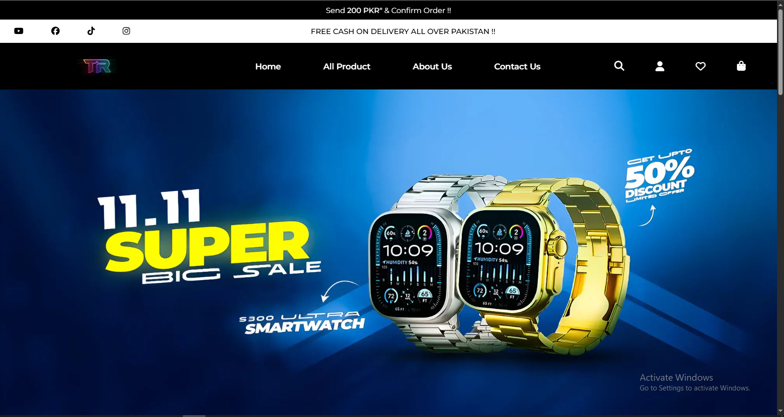

Slide 9
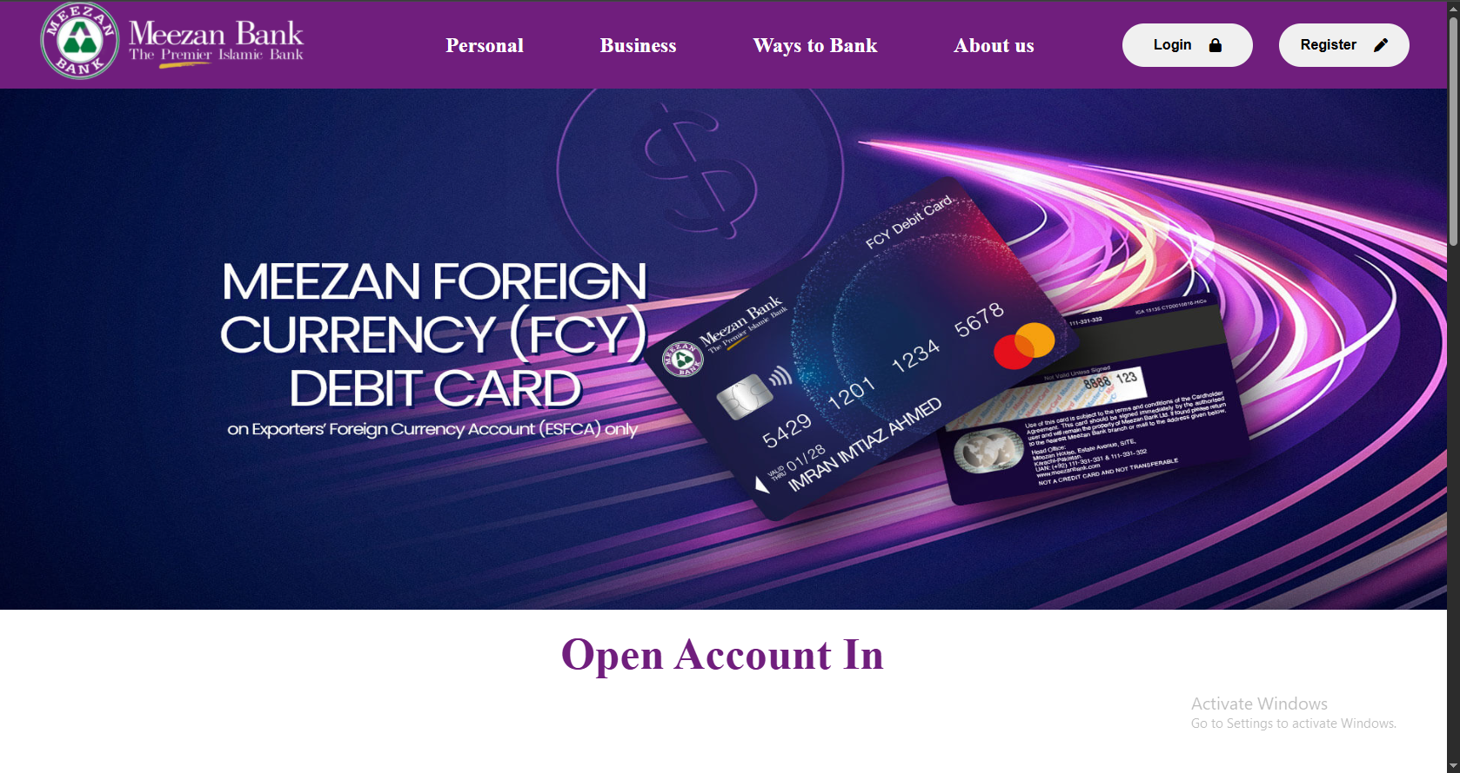

Slide 10
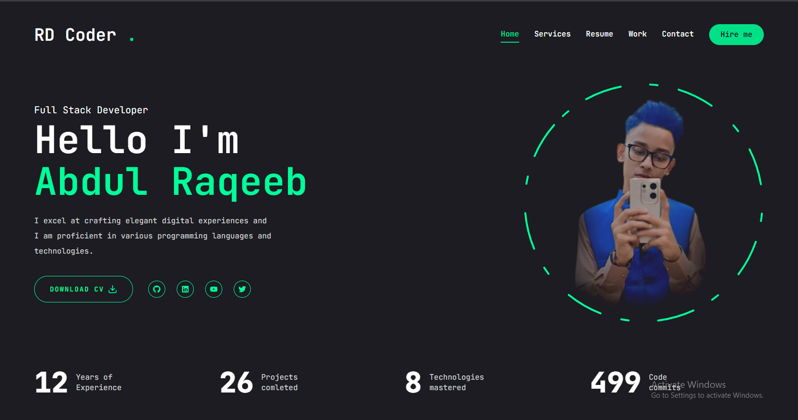

Slide 11
Final Thoughts & Advice For New Students
Keep practicing, build small things
Don’t fear errors — they teach you
Be consistent — learning
web dev is a journey!

Slide 12

Thank You Coders !

